Slide 1
Chime Managers
Training Session for

Slide 2
Training Session Overview
What Will This Training Session Be Covering?
Queue Settings
Adding and removing agents
Setting agent priority
Creating and editing text resources, standard replies, session tags etc.
Routing settings overview
Queue scheduling based on availability or schedule
Adding a Queue photo
Enable the Agent Context Window setting
Queue Dashboard
Active chat information, ASA, traffic
Desk Agents
Monitor and Details tabs
Charts and Metrics - Queue level charts
Agent tracking page for Managers
History Search page
System Dashboard
Managers limited to specific queues
Reports - System wide charts
Notes:
These are the main points that we will cover in the training session, so I will talk about them briefly.
At any point during the training session feel free top stop me if you have any questions because I will be switching between this and Chime so it might get confusing
To start off we are going to have a quick demo of Chime

Slide 3
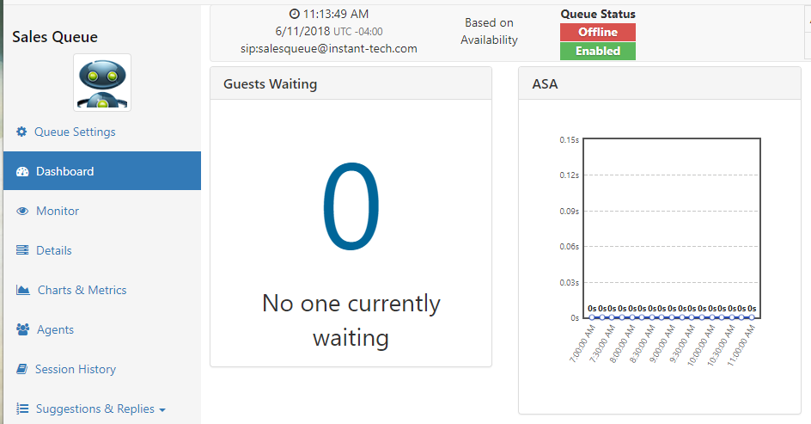
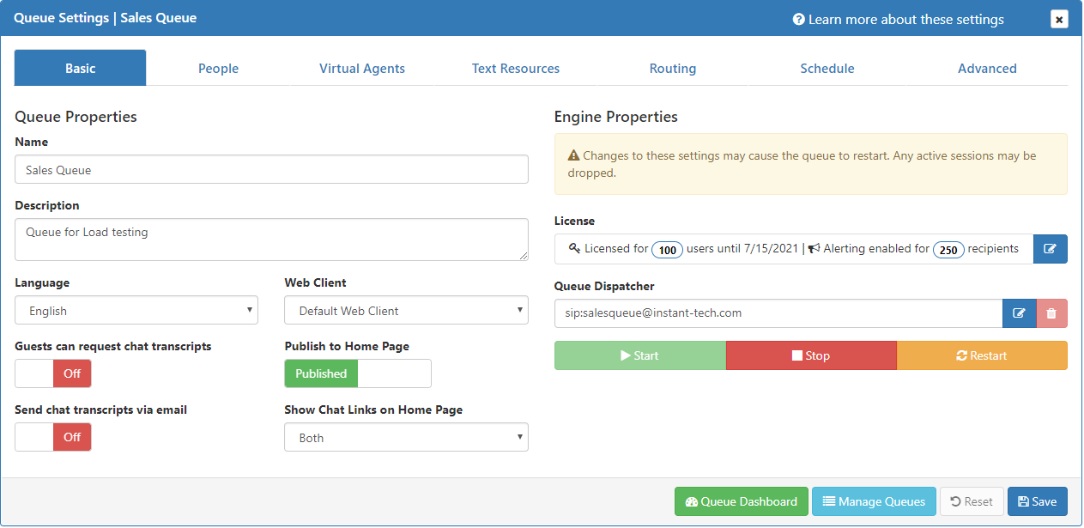
Queue Settings
Getting to the Queue Settings
Notes:
“Because of how important Queue Settings is to Chime we will briefly cover how to get there.
As a manager, there are two places that you can get to Queue Settings:
First is from the Manage Queues page which I will talk about more in a minute
And the Second is from the Queue Dashboard which we will cover more in the second half of the training session”

Slide 4
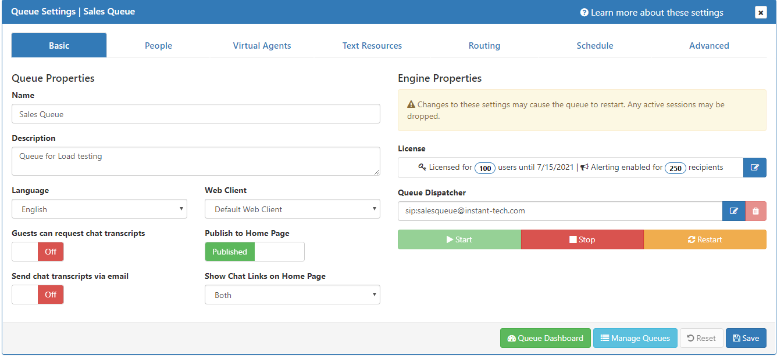
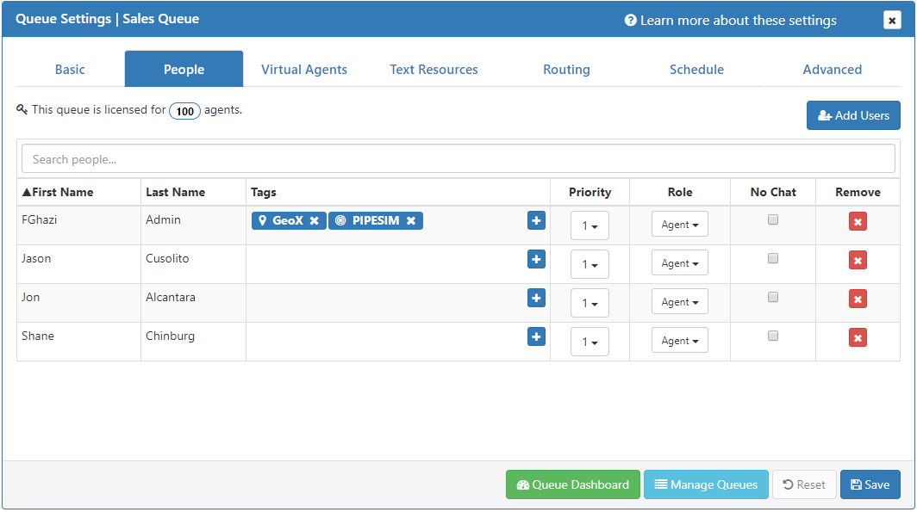
Queue Settings
Basic Settings
People Settings
Adding and removing agents
Setting agent priority
Notes:
“Now that we are in Queue Settings, we can start to cover the most common use cases in the different Tabs available in Queue Settings
The main tab you are sent to in Queue Settings is the Basic tab where you are able to make changes to some of the most important parts of the Queue such as the name, license, dispatcher and even the on/off state. Many of the settings in this area will require a queue restart when they are changed, so we recommend to change these at times when the queue is not in use.
The People Tab is where everyone assigned to the queue is added, edited or removed. I will give a quick demo of adding a new user to the queue, then explain all of the different settings that can be applied to the different people in the queue”

Slide 5
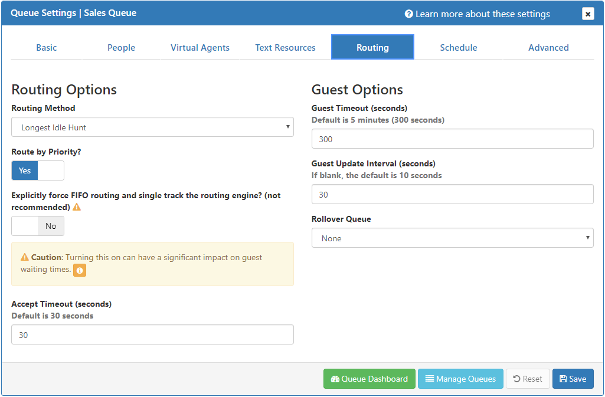
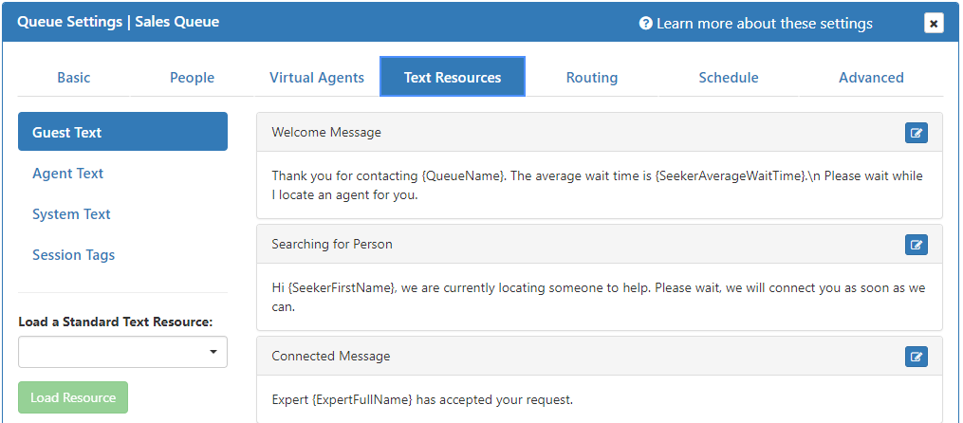
Queue Settings
Creating and editing text resources, standard replies, session tags etc.
Routing settings overview
Queue scheduling based on availability or schedule
Notes:
Show basic Text resourcing mention that it is something you will probably change infrequently
Routing Settings main topics are the routing type, priority, timeout, Guest timeout
Schedule is explaining the differences between schedule and availability

Slide 6
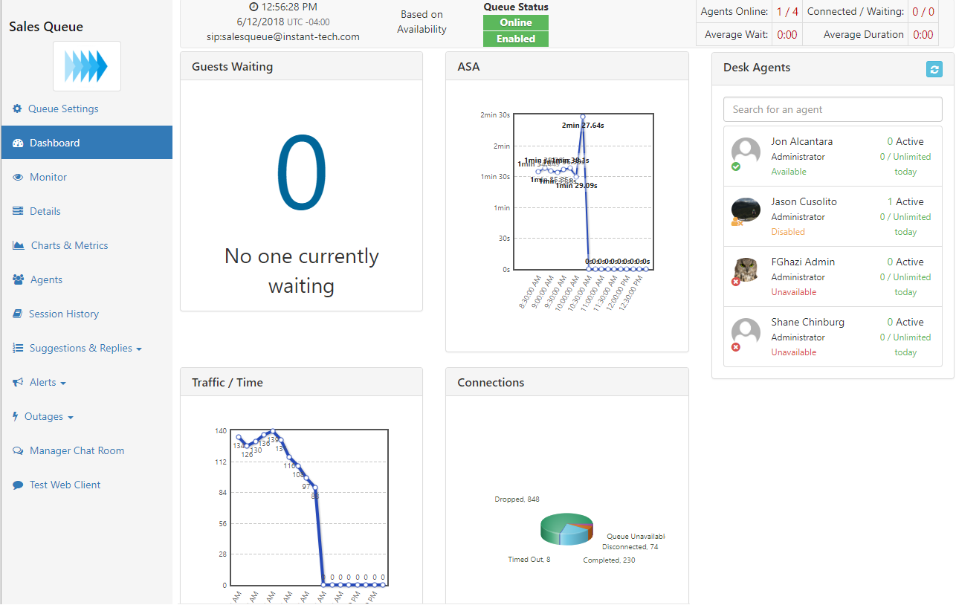
Queue Dashboard
Active chat information, ASA, traffic
Desk Agents
Monitor and Details tabs
Notes:
“The queue dashboard is a hub to allow managers and reviewers to see everything that is happening in a queue. You are able to see current chat sessions in the queue, look at history and look at statistics for example”
Go into explaining the Dashboard, Monitor and Details panels

Slide 7
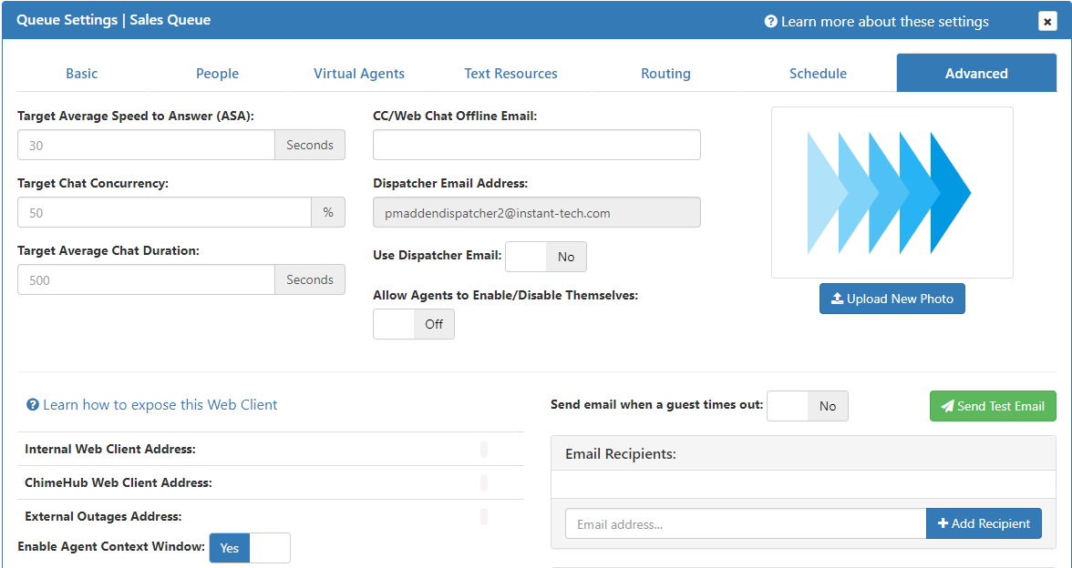
Queue Settings
Adding a Queue photo
Enable the Agent Context Window setting
Notes:
Covering the Advanced section will mainly be about adding queue image and enabling the context window.

Slide 8
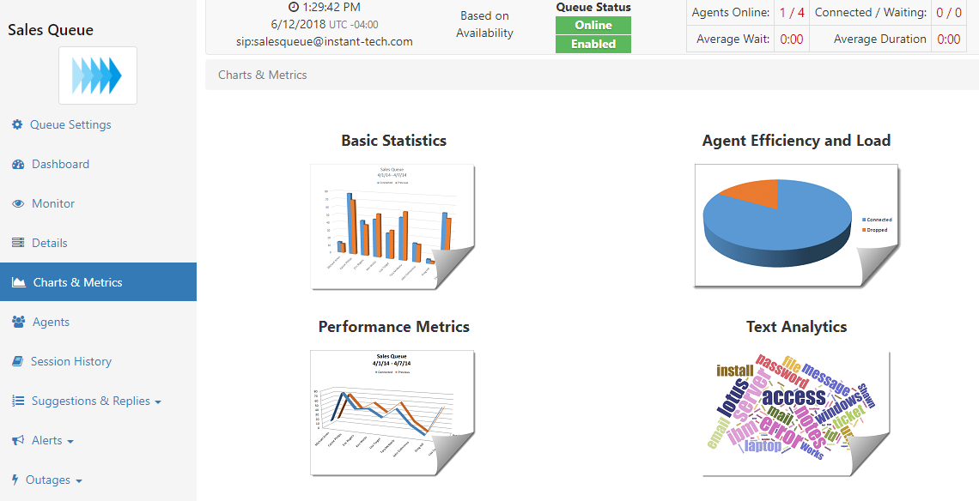
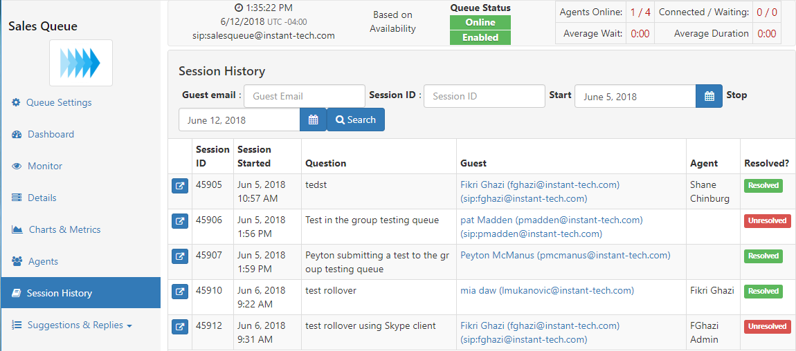
Queue Dashboard
Charts and Metrics - Queue level charts
Agent tracking page for Managers
History Search page
Notes:
Charts and Metrics: show ASA Over Time, Average Chat Duration, Inbound vs Answered, ASA by Agent, Concurrent Chat Percentage by Agent etc…

Slide 9
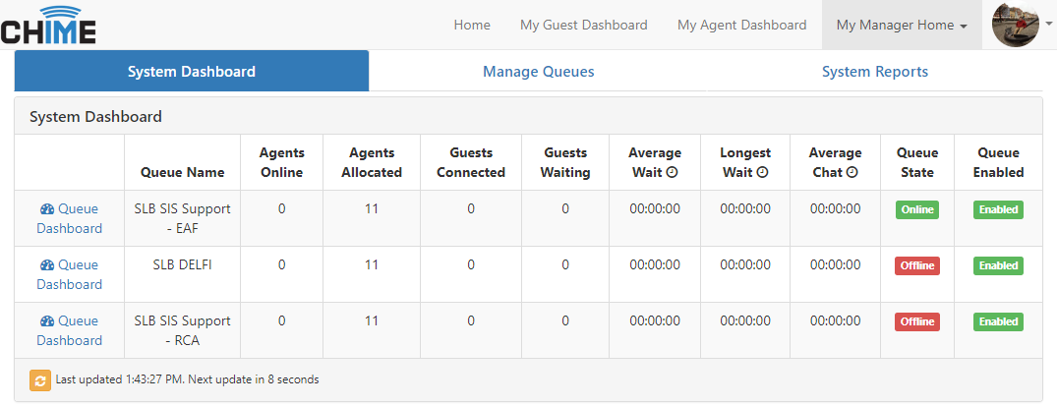
System Dashboard
Managers limited to specific queues
Reports - System wide charts
Notes:
Show off the System Dash and System results. Make sure to make it clear that the system reports are system level and not queue level

Slide 10
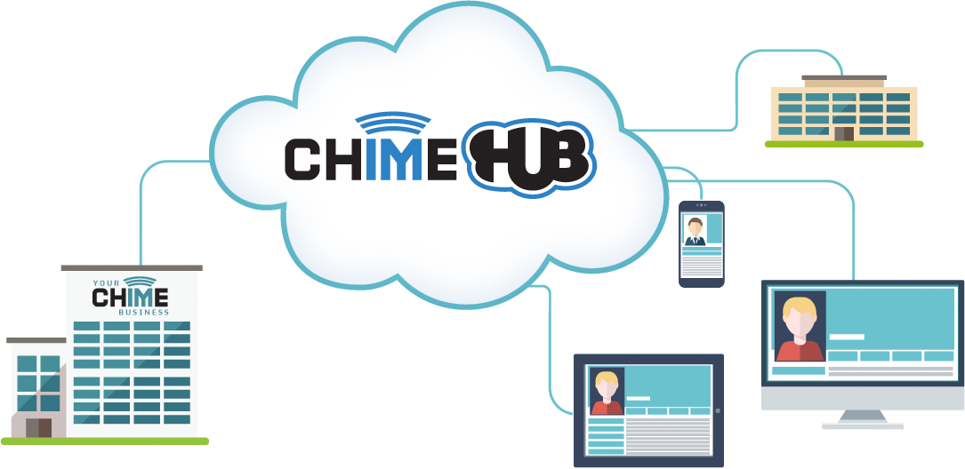
Chime Hub – Extend the Reach
Notes:
Quick ChimeHub demo of escalating to conference for screenshare and showing it in monitor panel

Slide 11
Any Questions?
Notes:
Ask for any questions here…

